Slide 1
PC613: Communication Skills
Sem I, MSc IT
Instructor: Dr. Jenson Joseph

Slide 2
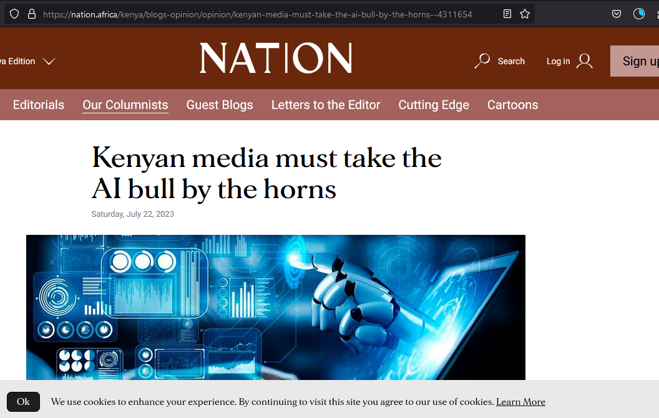
Learn an idiom
“take/grab the bull by the horns”

Slide 3
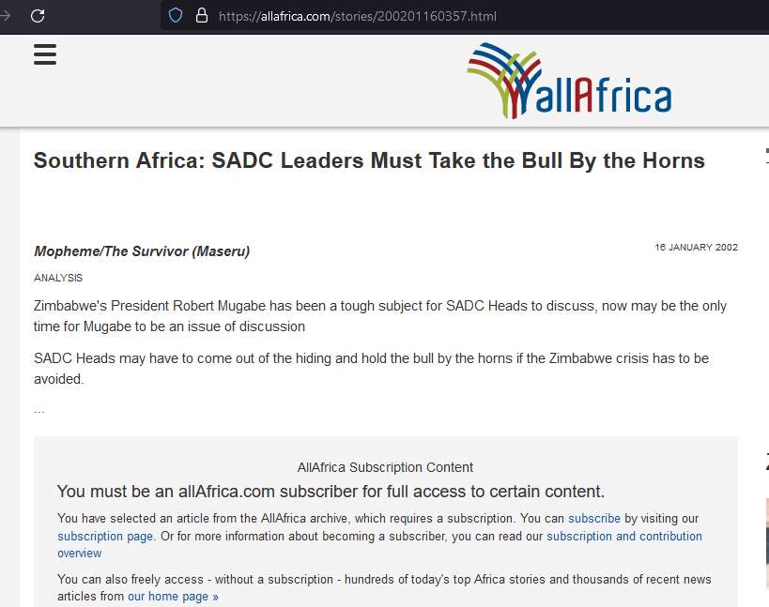
Learn an idiom
“take/grab the bull by the horns”

Slide 4
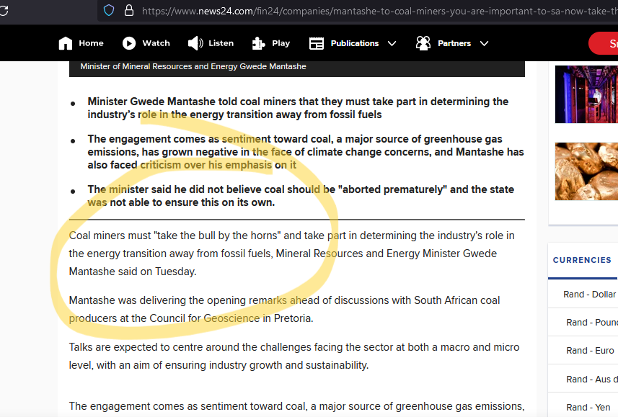
Learn an idiom
“take/grab the bull by the horns”

Slide 5
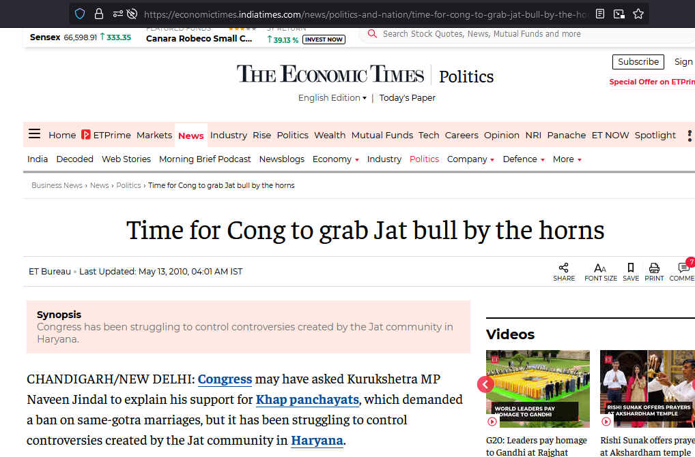
Learn an idiom
“take/grab the bull by the horns”

Slide 6
Learn an idiom
To take/grab the bull by the horns means:
-- to deal with a difficult situation in a very direct or confident way
-- to confront a problem head-on and deal with it openly.
-- to do something difficult in a brave and determined way.
Examples:
Why don't you take the bull by the horns and tell him to leave you alone?
Teachers must do something urgently to grab the ChatGPT-plagiarism bull by the horns.
She decided to take the bull by the horns and try to solve the problem without any further delay.
You've been complaining about being out of work for too long—it's time to take the bull by the horns and go find a job.

Slide 7
From the assignment
Correcting usages, grammar
Identify grammatical errors, and improper uses of phrases:
“The actor has left his home to become a musician, got cheated or well said he was left on hanger by his beloved so that she can marry someone her status. He is now alone, lost in this world. He made a choice to support his beloved even though he knew in the corner of his heart that this was supposed to happen again.”

Slide 8
From the assignment
Correcting usages, grammar
Rewrite by identifying grammatical errors, and improper uses of phrases:
The vagabond dude just goes wherever the wind takes him, no plans or anything.

Slide 9
From the assignment
Correcting usages, grammar
Rewrite by identifying grammatical errors, and improper uses of phrases:
ONCE HEALTHY RELATIONSHIP WAS NOW RAVAGED BY JEALOUSY AND TRUST ISSUES

Slide 10
From the assignment
Correcting usages, grammar
Rewrite by identifying grammatical errors, and improper uses of phrases:
ONCE HEALTHY RELATIONSHIP WAS NOW RAVAGED BY JEALOUSY AND TRUST ISSUES

Slide 11
From the assignment
Correcting usages, grammar
Rewrite by identifying grammatical errors, and improper uses of phrases:
AFTER FINAL SEMESTER EXAMS I BECAME VAGABOND CARRYING BACKPACK AND FEELING FREE WHILE TRAVELING BEAUTIFUL COUNTRY.

Slide 12
From the assignment
Correcting usages, grammar
Rewrite by identifying grammatical errors, and improper uses of phrases:
AFTER A TIRESOME DAY IN COLLEGE AS SOON AS I RETURNED HOME I GORGE ON SNACKS AND SOFT DRINKS.

Slide 13
From the assignment
Correcting usages, grammar
Rewrite by identifying grammatical errors, and improper uses of phrases:
So I think our life is like this only no matter how much you try there are few uncertain things which we can’t control and we try to live with it.

Slide 14
From the assignment
Correcting usages, grammar
Rewrite by identifying grammatical errors, and improper uses of phrases:
Children are not allowed to gorge on sweets because they are bad for their teeth.

Slide 15
About the assignment
The assignment was called “Construct A Scenario”: Don’t try to make a blockbuster with multiple scenes, flashbacks, jump-cuts and so on. Just write a simple conversation set in ONE scenario.
Cut down on that sarcasm: let’s first learn to speak in simple direct language. Then try to write like Chetan Bhagat or Shakespeare or Kalidasa.
https://chat.openai.com/

